Slide 1

Entity Relationship Diagram (ERD) for Omega Manufacturing’s Order Processing System
A structured approach to efficient order processing and inventory management
Presented by: Ayanfe Moses Asulewon

Slide 2

Overview
Problem Statement: Omega Manufacturing currently relies on spreadsheets and emails, causing delays, errors, and lack of real-time visibility.
Solution: Implementing a centralized order processing system using Dataverse.
Objective: Automate workflows, reduce manual errors, and provide real-time insights.

Slide 3
Core Tables (Entities) & Fields
1. Customer: Stores customer-related data (e.g., CustomerID, Name, Email, Phone, Address).
2. Product: Stores product details (e.g., ProductID, ProductName, Description, Price, Category).
3. Customer Order: Tracks customer orders (e.g., OrderID, CustomerID, OrderDate, OrderStatus, OrderTotal).
4. Order Item: Details of products in each order (e.g., OrderItemID, OrderID, ProductID, Quantity, UnitPrice).
5. Inventory: Manages stock levels (e.g., ProductID, StockLevel, LastUpdated, Location).

Slide 4
Relationships Between Tables
Customer ? Customer Order: One customer can place multiple orders.
Customer Order ? Order Item: One order can contain multiple order items.
Product ? Order Item: A product can appear in multiple orders.
Product ? Inventory: Each product has a corresponding inventory record.

Slide 5
ERD Diagram
Visual representation of relationships between entities.
Demonstrates how data flows seamlessly across departments.

Slide 6
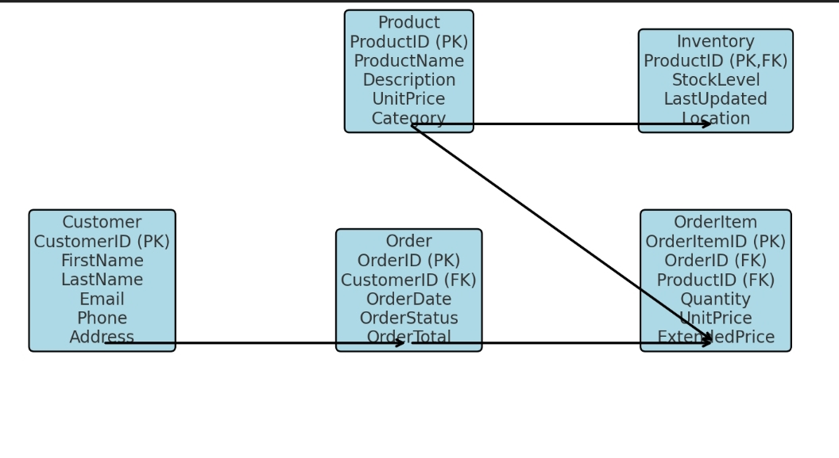
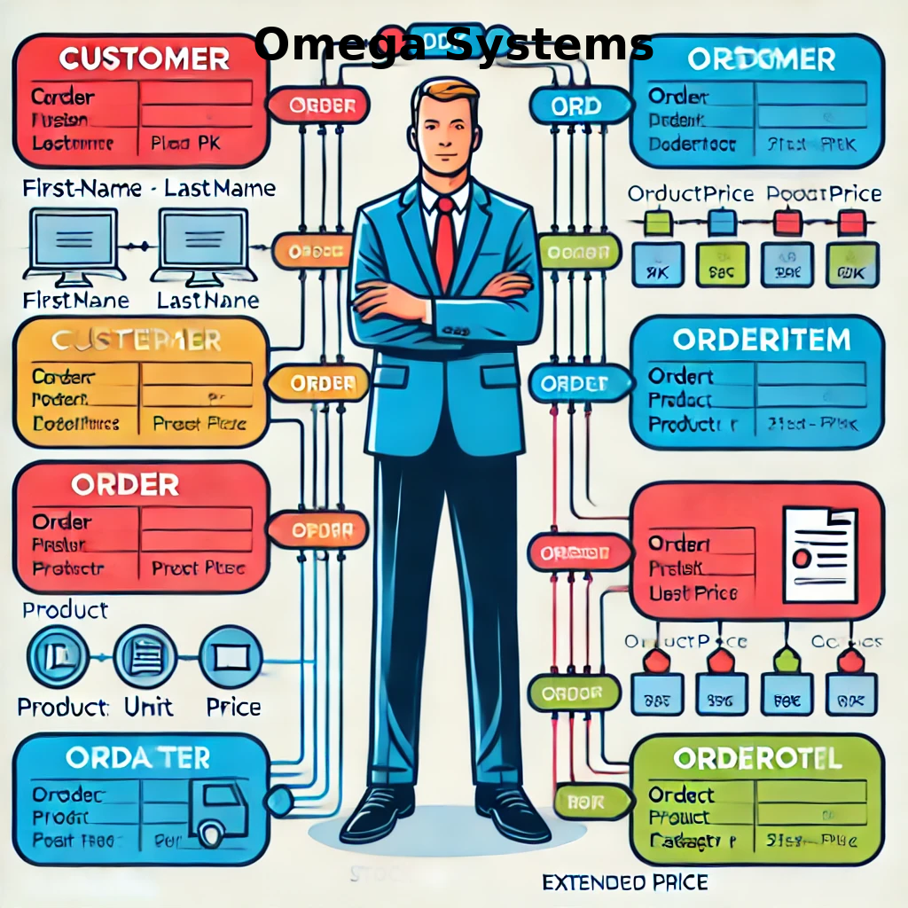
ERD Diagram
Visual representation of relationships between entities.
Demonstrates how data flows seamlessly across departments.

Slide 7
Advantages of Implementation
Improved Efficiency: Automation of order processing reduces manual work.
Real-Time Visibility: Inventory and order tracking enable better decision-making.
Data Accuracy: Centralized database eliminates redundancy and errors.
Scalability: Can support growing business needs.
Seamless Integration: Works with Microsoft Power Platform for reporting and automation.

Slide 8
Implementation Plan
Step 1: Define system requirements and user roles.
Step 2: Develop the Dataverse schema and establish relationships.
Step 3: Configure Microsoft Power Apps and Power Automate for workflows.
Step 4: Test with sample data and refine the process.
Step 5: Deploy, train employees, and monitor performance.

Slide 9

Conclusion
The ERD-based system streamlines Omega Manufacturing’s order processing.
Ensures accuracy, efficiency, and data-driven decision making.
Ready for digital transformation with Microsoft Power Platform.
Looking forward to implementation and driving business growth.

Slide 10
Q&A
- Open floor for questions and further discussions.

